Slide 1
Introduction to R
Sulochan Dhungel
1/26/2017
sulochandhungel@gmail.com

Slide 2
R - Introduction
Language for data manipulation, calculation and graphical display
Free
Similar to MATLAB
Developed as a statistical tool
Packages – tools developed by different people/organizations which are powerful add-ons to default R program

Slide 3
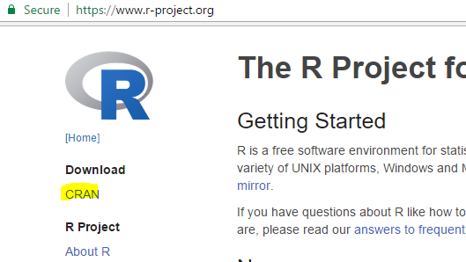
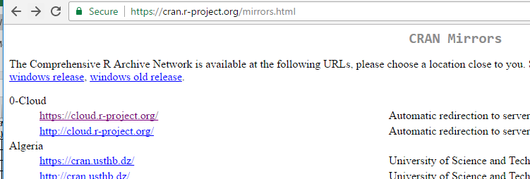
Installing R
Go to https://www.r-project.org/
Choose any mirror and download R (for Windows).

Slide 4
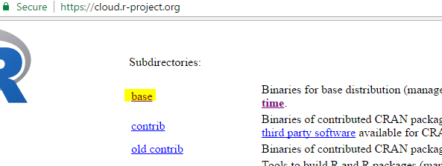
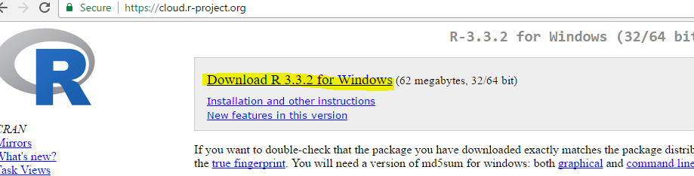
Installing R
Get the “base” package
Then download the file

Slide 5
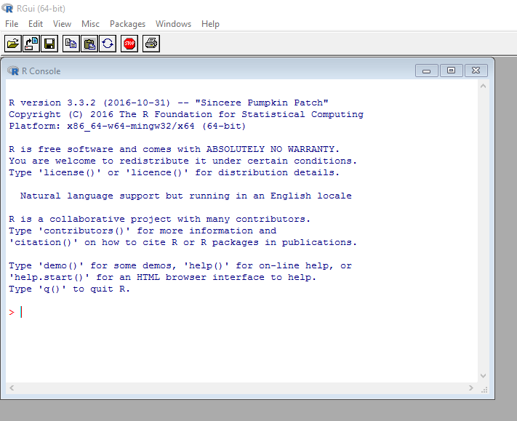
After installing

Slide 6
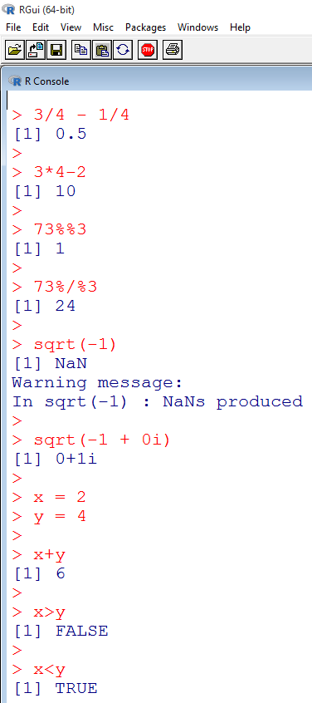
Simple calculations at the terminal
  Addition, Subtraction,…
  Remainder (%%)
  Quotient (%/%)
  Square root
  Complex numbers
  Variable assignments
  Logical comparisons

Slide 7
R Data
Basic Data Types – Numeric, Character, Complex, Logical
Vector
Matrix
List
Data Frames

Slide 8
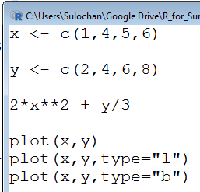
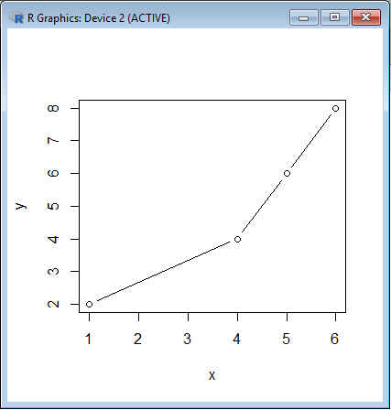
R Vectors
(Open a new script and save it. Do not work on terminal)
Very useful data structure in R.
Run each line using “Ctrl+R”
See the result in terminal

Slide 9
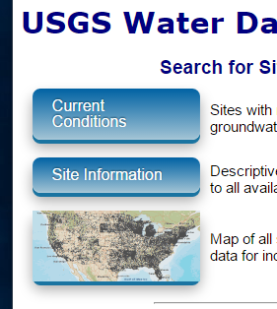
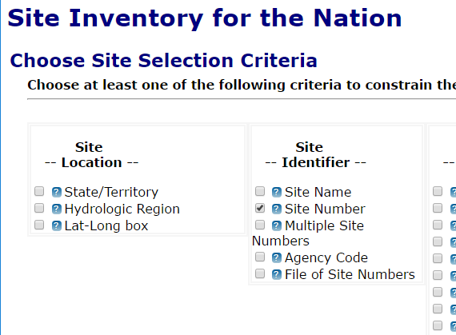
Download instantaneous flow data from USGS
https://waterdata.usgs.gov/nwis
Go to Site Information
Check “Site Number” and Submit

Slide 10
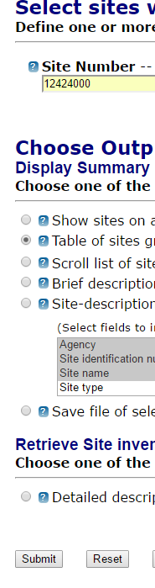
Download instantaneous flow data from USGS
https://waterdata.usgs.gov/nwis
Go to Site Information
Check “Site Number” and Submit
Put in the site number as “12424000”
Check “Table of sites” in output format and click Submit

Slide 11
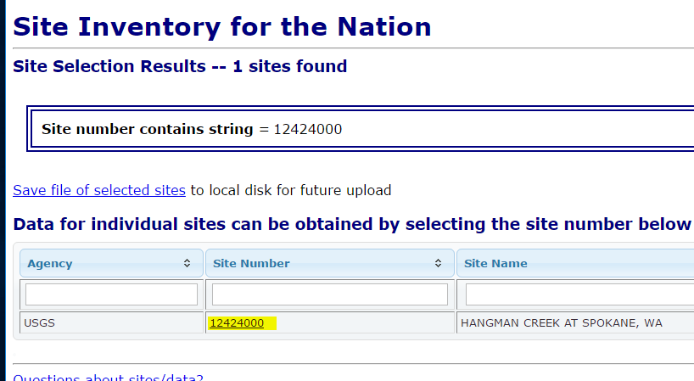
Download instantaneous flow data from USGS
https://waterdata.usgs.gov/nwis
Go to Site Information
Check “Site Number” and Submit
Put in the site number as “12424000”
Check “Table of sites” in output format and click Submit
Click the Site Number “12424000” to get to the webpage for the specific site

Slide 12
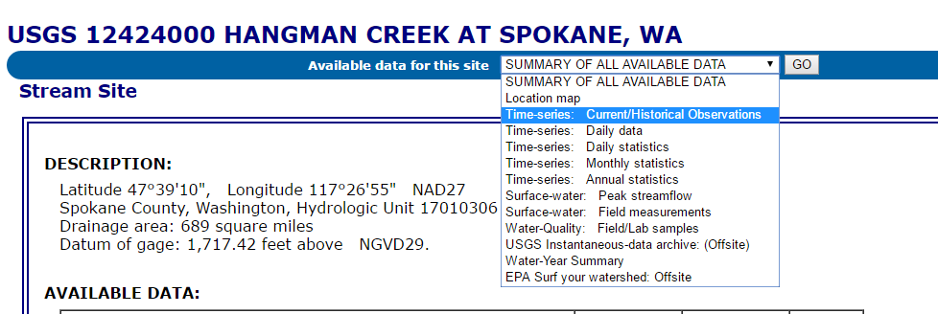
Download instantaneous flow data from USGS
Select “Time Series: Current/Historical observations” and click “Go”

Slide 13
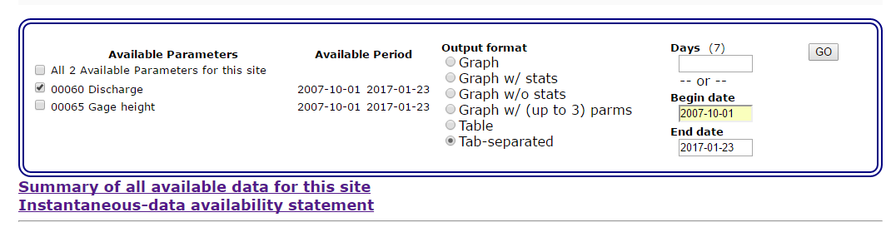
Download instantaneous flow data from USGS
Based on available period “2007-10-01”, put begin date and leave end date as default.
Select Tab-separated as Output format.
Uncheck Gage Height and click “GO”
After a few moments, the data appears as a table.
Right Click -> Save as “12424000” as a text file.

Slide 14
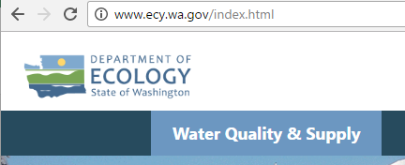
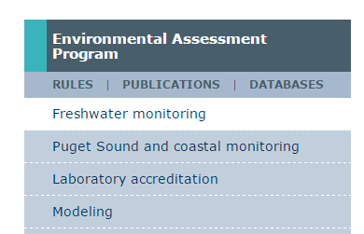
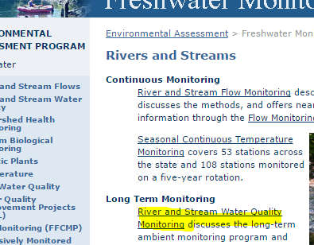
Download DO data
http://www.ecy.wa.gov/index.html
Select “Water Quality and Supply”
Select “Freshwater monitoring” under Environmental Assessment Program
Under “Long Term Monitoring” click on “River and Stream Water Quality Monitoring”

Slide 15
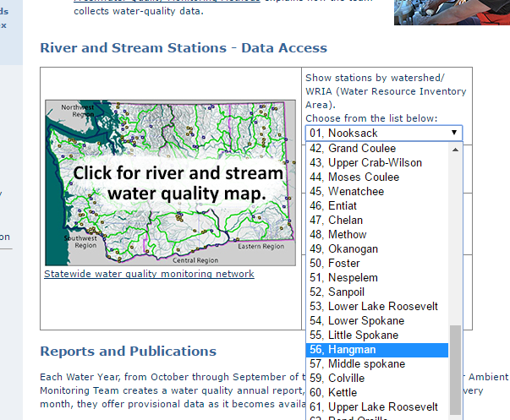
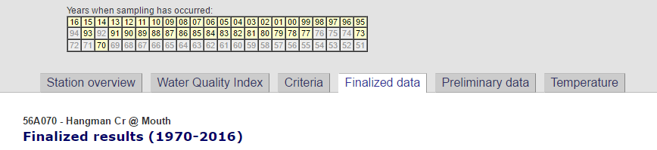
Download DO data
In the resulting page, either click on the map to select the station for hangman creek OR Choose from the list “56, Hangman”
Go to the “Finalized data” tab

Slide 16
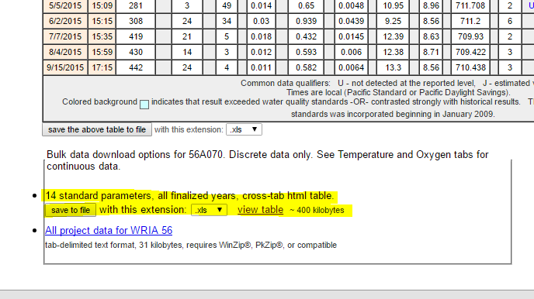
Download DO data
Go down to “14 standard parameters, all finalized years, cross-tab html table” and click “save to file” with extension as “.xls”
The data is saved as an excel file.
Save it as a csv file.

